Slide 1

Crowdsourcing Metadata – Challenges and Outlook
Washington, 10 May 2016
Lars Vilhuber, William Block (Cornell University)
Notes:
Abstract:
Recent years have shown the power of user-sourced information evidenced by the success of Wikipedia and its many emulators. Agencies on the other hand publish metadata on their data products, but have little opportunity to get structured feedback on that metadata (codebooks) from their users. Creating and augmenting metadata is a labor-intensive endeavor. Harnessing collective knowledge from actual data users can supplement officially generated metadata. As part of our Comprehensive Extensible Data Documentation and Access Repository (CED²AR) infrastructure, we demonstrate a prototype of crowdsourced metadata (codebooks), using DDI-C and supplemental XML. The system allows for any number of network connected instances (web or desktop deployments) of the CED²AR DDI editor to concurrently create and modify metadata. The backend transparently handles changes, and frontend has the ability to separate official edits (by designated curators of the data and the metadata) from crowd-sourced content. Features of the software allow official curators to merge in select enhancements into revisions of official documentation. CED²AR ingests and publishes widely-used DDI metadata standards, and can thus easily augment existing metadata publishing systems. Using standards-compliant ingest and publication methods, our proposed crowd-sourced metadata system can greatly enhance user acceptance of documentation, user-engagement in the documentation process, and reduce agency costs while improving the quality of data documentation. This development is part of the NSF-Census Research Network node at Cornell University.

Slide 2

Crowdsourcing Metadata – Challenges and Outlook
Washington, 10 May 2016
Lars Vilhuber, William Block (Cornell University)
Notes:
Abstract:
Recent years have shown the power of user-sourced information evidenced by the success of Wikipedia and its many emulators. Agencies on the other hand publish metadata on their data products, but have little opportunity to get structured feedback on that metadata (codebooks) from their users. Creating and augmenting metadata is a labor-intensive endeavor. Harnessing collective knowledge from actual data users can supplement officially generated metadata. As part of our Comprehensive Extensible Data Documentation and Access Repository (CED²AR) infrastructure, we demonstrate a prototype of crowdsourced metadata (codebooks), using DDI-C and supplemental XML. The system allows for any number of network connected instances (web or desktop deployments) of the CED²AR DDI editor to concurrently create and modify metadata. The backend transparently handles changes, and frontend has the ability to separate official edits (by designated curators of the data and the metadata) from crowd-sourced content. Features of the software allow official curators to merge in select enhancements into revisions of official documentation. CED²AR ingests and publishes widely-used DDI metadata standards, and can thus easily augment existing metadata publishing systems. Using standards-compliant ingest and publication methods, our proposed crowd-sourced metadata system can greatly enhance user acceptance of documentation, user-engagement in the documentation process, and reduce agency costs while improving the quality of data documentation. This development is part of the NSF-Census Research Network node at Cornell University.

Slide 3
Acknowledgements
Based on work with
Benjamin Perry (formerly Cornell University)
Venkata Kambhampaty (formerly Cornell University)
Kyle Brumsted (McGill University)
Jeremy Williams (Cornell University)
Carl Lagoze (University of Michigan)
John Abowd (Cornell University)
and materials presented in INFO 7470, all of that with funding by NSF Grant #1131848

Slide 4
I’m going to argue that…
Replicability is a problem…
and (A) easier deposit methods could alleviate it
but progress is slow

Slide 5
I’m going to argue that…
Having replicable archives shifts the problem…
in time: (B) older articles cannot be linked to data
in scope: (C) curators need expert help in documenting the data

Slide 6
A test
LDI “reproducibility” project:
Kingi, Stanchi, Vilhuber (2016, unpublished) “The Reproducibility of Economics Research”

Slide 7
Kingi, Stanchi, Vilhuber (2016)
109 articles in American Economic Journal: Applied Economics
Simpler test:
Do the provided data and programs yield the published results?

Slide 8
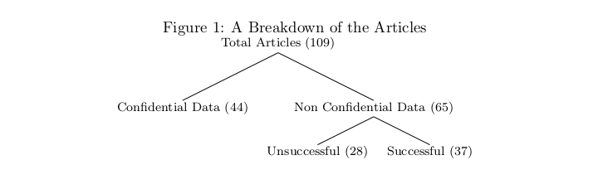
Kingi, Stanchi, Vilhuber (2016)

Slide 9
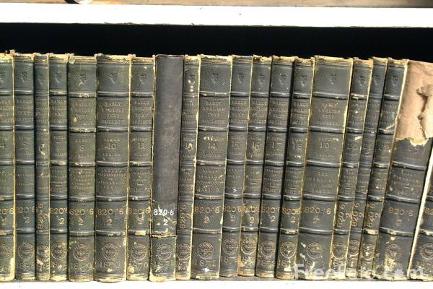
The old source of knowledge – and data!
Source: http://www.thecontrarianmedia.com/2011/08/dispatches-from-the-stacks-15/
License unknown

Slide 10

https://www.flickr.com/photos/15472273@N07/6931305440/in/photolist-byuKCd-oh6Bxu-bMpoYn-aUxMUX-aUxPKF-aUxNwv-aUxNiH-aUxN2V-aUxNb6-aUxNqe-aUxP4F-aUxNLB-biAicF-biA9ar-aUxMte-biAftF-aUxLXr-aUxLKT-aUxMBc-fUMhDZ-pQm1F1-oaGC6t-6Juv4g-6JuiTM-oh78Mr-oyA1Gk-qssnzU-bMpunF-byuB5L-bMpf3n-qKP4GF-qKDrYF-dBNTRV-hEQRCt-Eag36-6Juv46-6Juv3R-6JxXpw-6Ju7Rt-6JxXpN-eJGN8U-6JuiTB-6JuiTx-6JuiU4-6JsUMD-6JsUMZ-6JuiTg-6Ju7R6-6Ju7RH-6JxXpo (Stadtbibliothek Stuttgart am Mailänder Platz) CC 2.0
Notes:
Even if this may be the future

Slide 11

The City – by Lori Nix
https://louisvillephotobiennial.files.wordpress.com/2015/05/library.jpg
License unknown

Slide 12

Options are available
Social and behavioral sciences

Slide 13
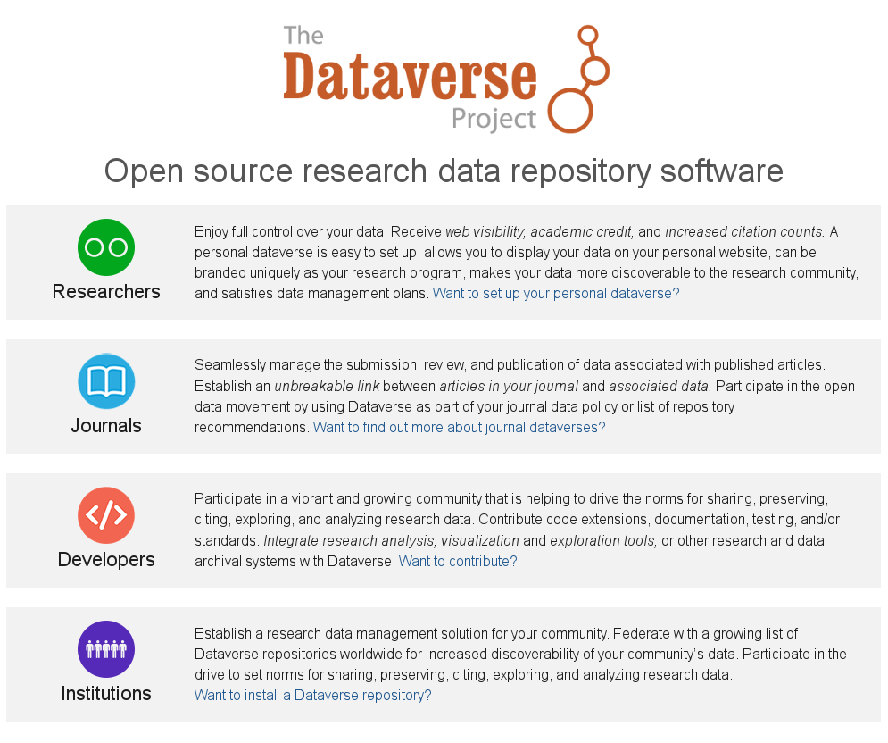
Options are available
“Research data”

Slide 14
Researchers don’t use them
Training? Incentives? Ease of use?

Slide 15
A Good Example

Slide 16
Gentzkow, Shapiro, Sinkinson (2014)
Gentzkow, Matthew, Jesse M. Shapiro, and Michael Sinkinson. 2014. "Competition and Ideological Diversity: Historical Evidence from US Newspapers." American Economic Review, 104(10): 3073-3114. DOI: 10.1257/aer.104.10.3073
Data at http://doi.org/10.3886/E1361V3

Slide 17
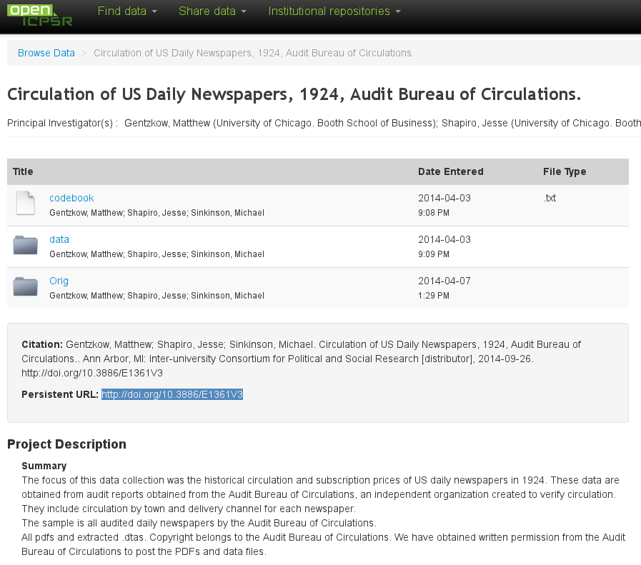

Slide 18
What’s good about this?
Permanent URL
Availability of
Original data
Transformed data
Open availability
Easy online inspection

Slide 19
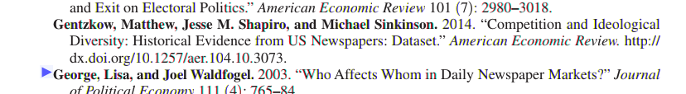
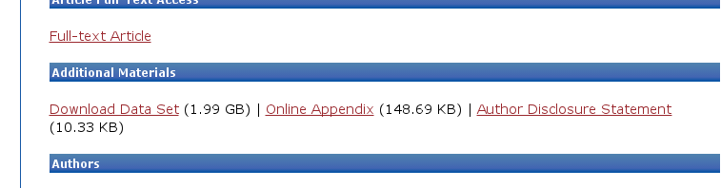
Not Perfect
Archive at openICPSR not actually tied to article and vice-versa
Conversely, “online appendix” just a “blob”

Slide 20
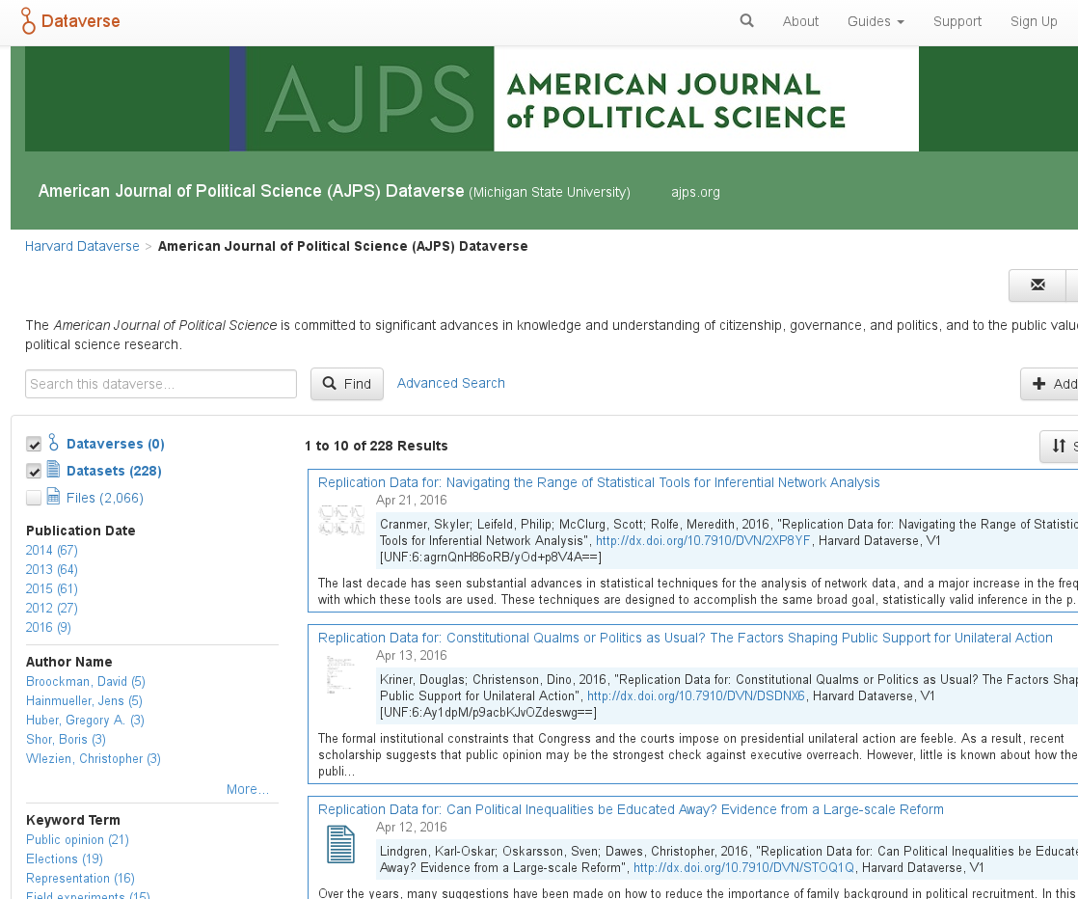
Journals are starting to use them

Slide 21
But the biggest problem…

Slide 22
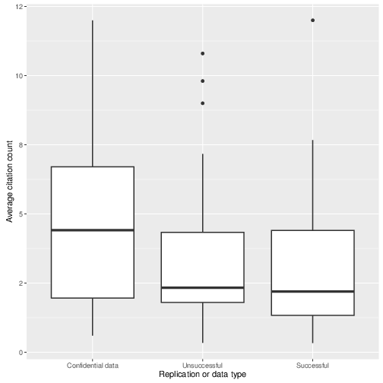
Back to confidential data
Articles using confidential data are (weakly) more cited than others

Slide 23
But: for confidential data…
Data is not available
Metadata is not available
Programs? So-so…

Slide 24

Should We Just Trust These Guys?

Slide 25
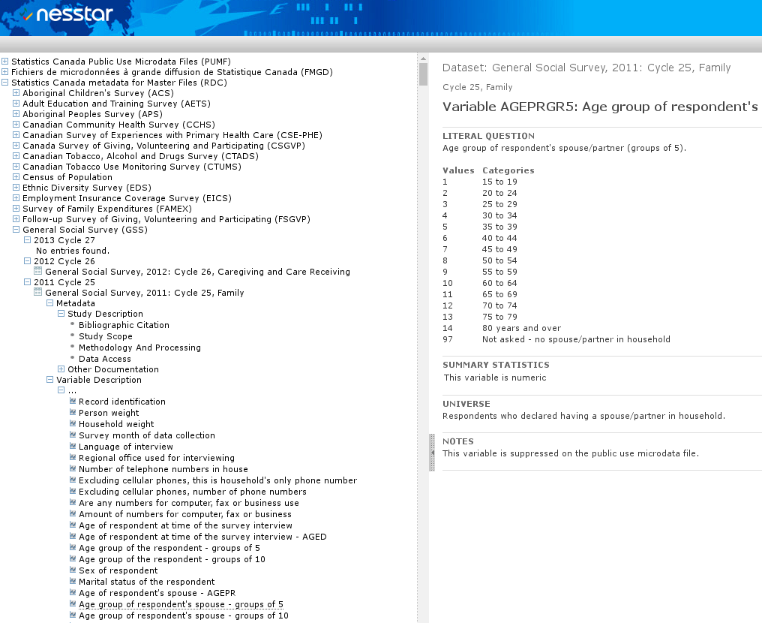
Some are quite commendable

Slide 26
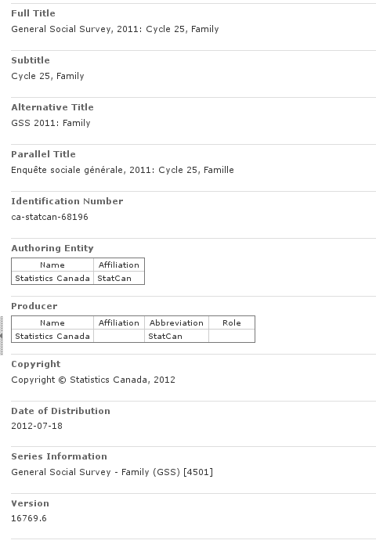
Even detailed information

Slide 27
How many users actually use that?

Slide 28
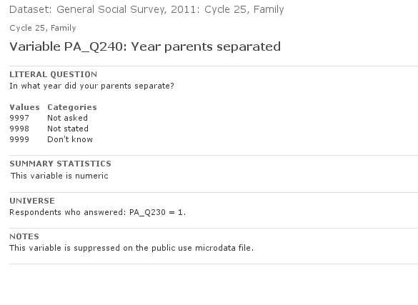
Data documentation is dry
How reliable is that question?

Slide 29
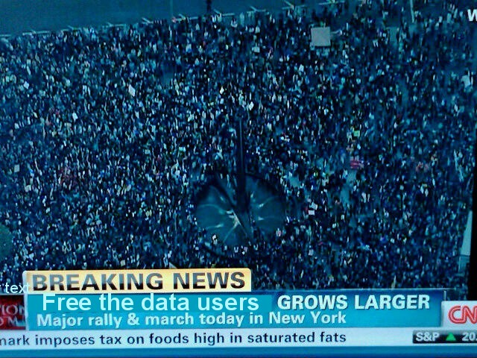
Don’t (just) liberate the data!
Liberate the data users!

Slide 30
Our contribution
Leverage researcher knowledge

Slide 31
Our Approach
Rely on open standards, namely the Data Documentation Initiative (DDI) schema
Provide easy-to-use tools and interfaces to structured metadata
Build infrastructure that enables data curators to leverage community-driven input to official documentation

Slide 32



How?
CED²AR
The Comprehensive Extensible Data Documentation and Access Repository
Notes:
Pronounced /ˈsidər/, like a cedar tree

Slide 33
What is CED²AR?
Metadata curation software
Designed for documenting existing datasets
Funded by NSF grant #1131848
Online at www2.ncrn.cornell.edu/ced2ar-web

Slide 34
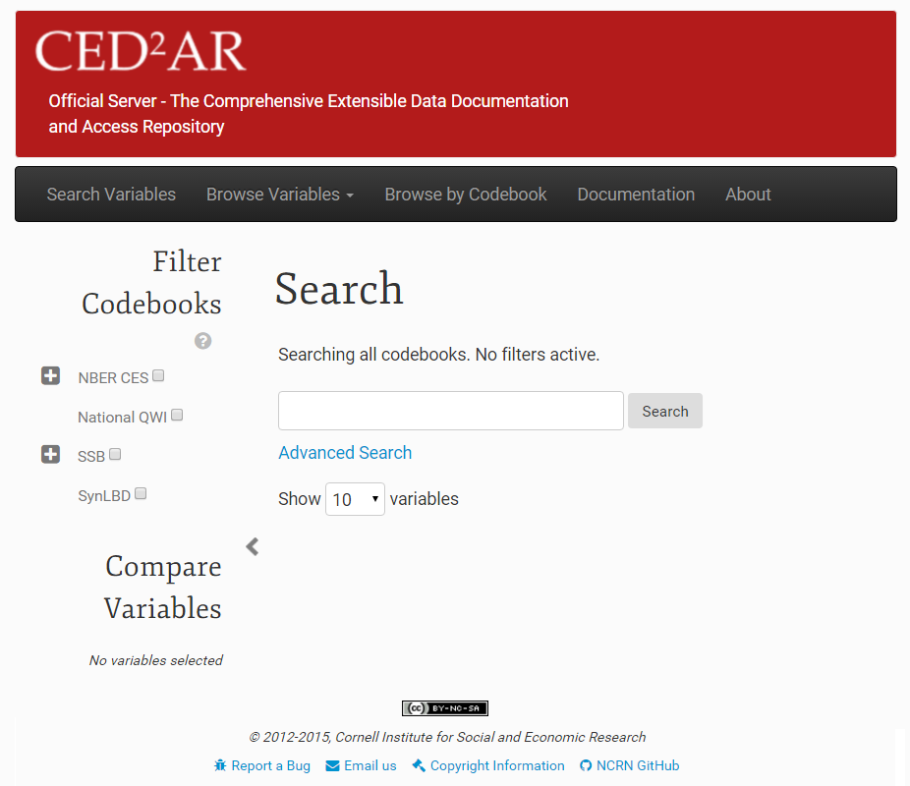
What is CED²AR?
Notes:
Web based, open source, and free for non-commercial use

Slide 35
Basic Information Flow
Staging Area
Public Facing
Official
Metadata
Datasets
Internal
Metadata
User switches
Crowdsourced
Metadata
35
Notes:
Instances of CED²AR are networked together in a distributed system – no centralized repository Three key instances exist for the curation process
An internal server to stage metadata
An official server to publish metadata
A crowdedsourced, or community server open to modifications
Metadata moves between all three instances

Slide 36
Basic Information Flow
Staging Area
Public Facing
Official
Metadata
Datasets
Internal
Metadata
User switches
Crowdsourced
Metadata
36

Slide 37
Internal Processing
1. Creation of skeletal metadata
Assuming data is already curated
Converting data into standardized metadata
Tools included (for SAS, Stata, SPSS, CSV), not discussed here
2. Hand editing and subsetting
Adding verbose descriptions
Applying disclosure limitation
3. User accessible
These tools can be manipulated by normal users
They could be incorporated into existing workflows

Slide 38
Internal Processing
Simple editing interface
Web-based, with limited rich text features
Math allowed (LaTeX)
Feedback
Completeness of codebook?
Without technical jargon!
Can be tuned

Slide 39
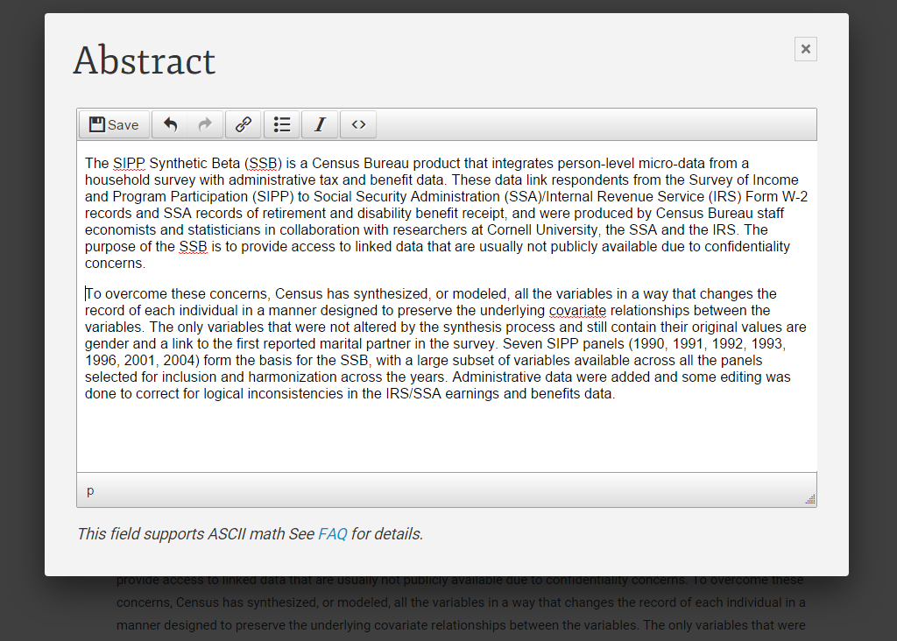
Internal Processing: Hand Editing

Slide 40
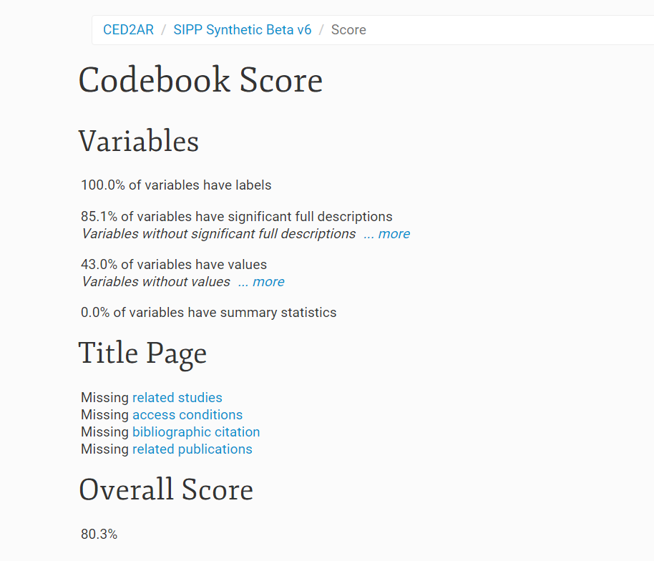
Internal Processing: Scoring
Provide feedback to improve sparse documentation

Slide 41
Fine-grained access controls
Important when working with confidential (meta)data

Slide 42
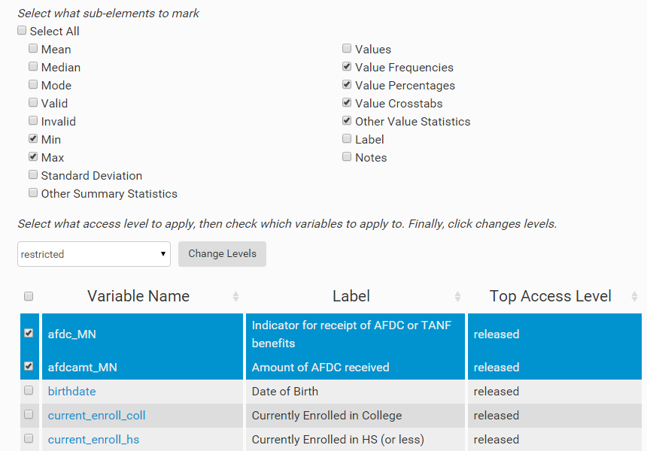
Internal Processing: Access Control
Marking elements with different restrictions
Notes:
Gives users the ability omit specific elements such as summary statistics, and frequencies

Slide 43
Workflow control
Ability to view additions/subtractions
Between versions
Between crowd-sourced information and official information
Ability to control access
Editing versus viewing
Authentication and reputation

Slide 44
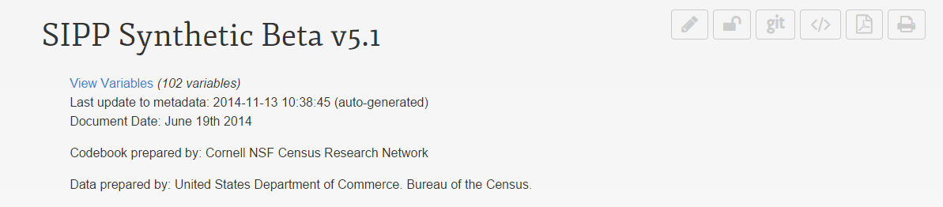
Versioning
Uses Git, a distributed version control system
Every aspect of the system is configurable
Scheduled tasks check for changes
Once changes exceed threshold, they are pushed
Remote instances pull changes on demand
Notes:
All instance use versioning!

Slide 45
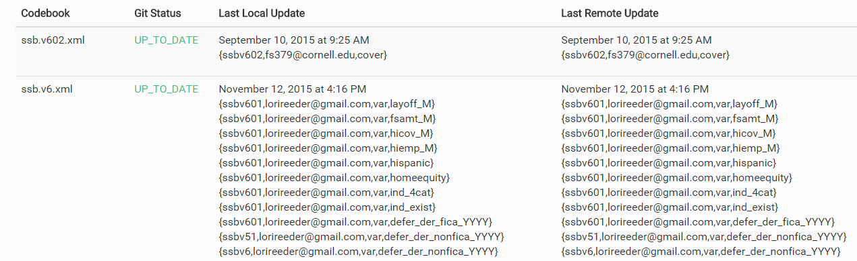
Combining Knowledge
Viewing changes made
Notes:
Managing a distributed network of metadata

Slide 46
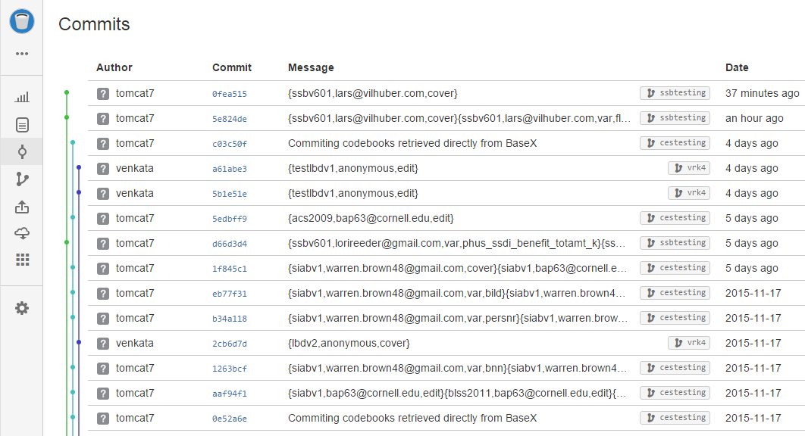
Versioning
All changes are logged externally via Git

Slide 47
Basic Information Flow
Staging Area
Public Facing
Official
Metadata
Datasets
Internal
Metadata
User switches
Crowdsourced
Metadata
47
Notes:
Public facing instances can ingest metadata from staging area on demand

Slide 48
Basic Information Flow
Staging Area
Public Facing
Official
Metadata
Datasets
Internal
Metadata
User switches
Crowdsourced
Metadata
48

Slide 49
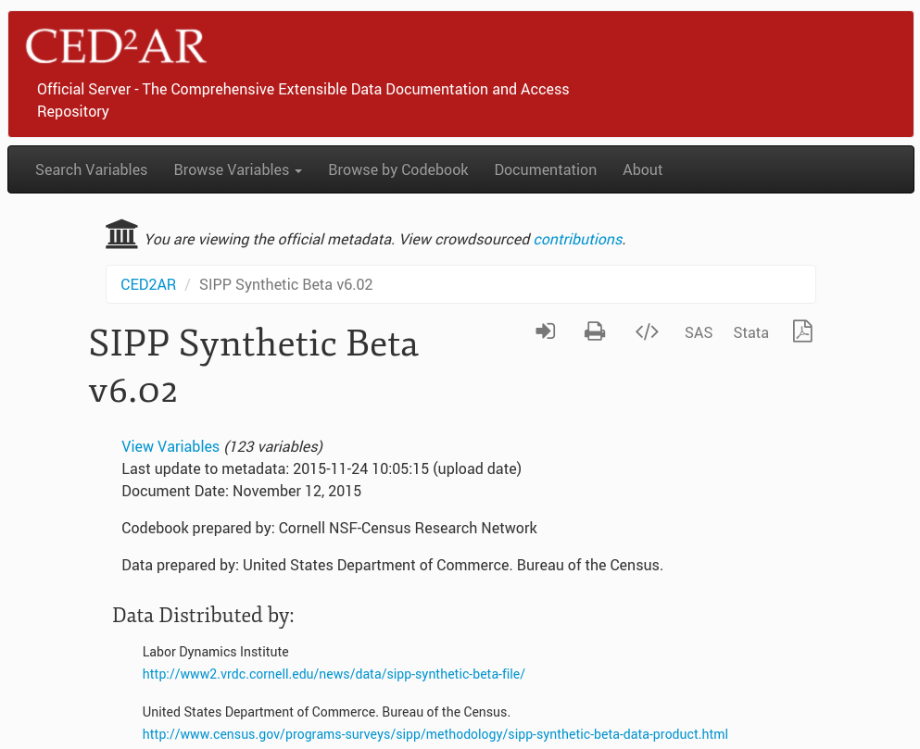

Official view

Slide 50
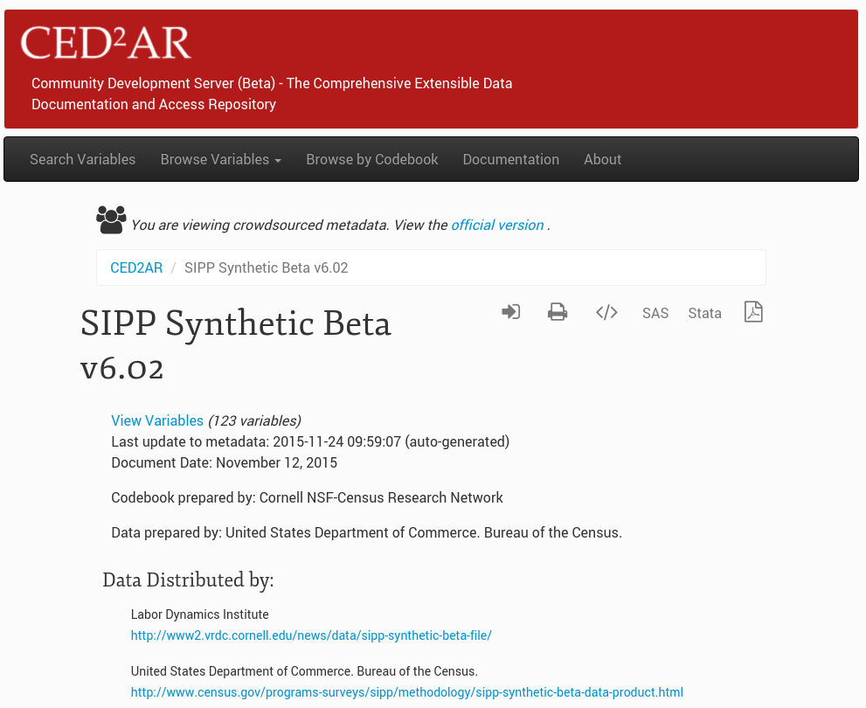

Crowdsourced view

Slide 51
Authentication and Attribution
When opening up contributions to a wide audience, how to triage between “rants” and meaningful contributions?
Here: Use of ORCID (academic network) for authentication
Public attribution with link to (verified) academic ID is key for positive feedback (your effort is recognized) and prevention of negative contribution (your rant is traceable to you!)

Slide 52

Authentication
Supports OpenID and OAuth2
Currently using Google and ORCID with OAuth2
Developing connectors to work with additional providers
CED²AR handles identity management
Notes:
Authentication is also important internally (small-workgroup editing!)
Possible Providers:
-Office 365 via Azure Active Directory
-GitHub
-Stack Exchange
-Facebook
-LinkedIn

Slide 53
Editing made easy

Slide 54
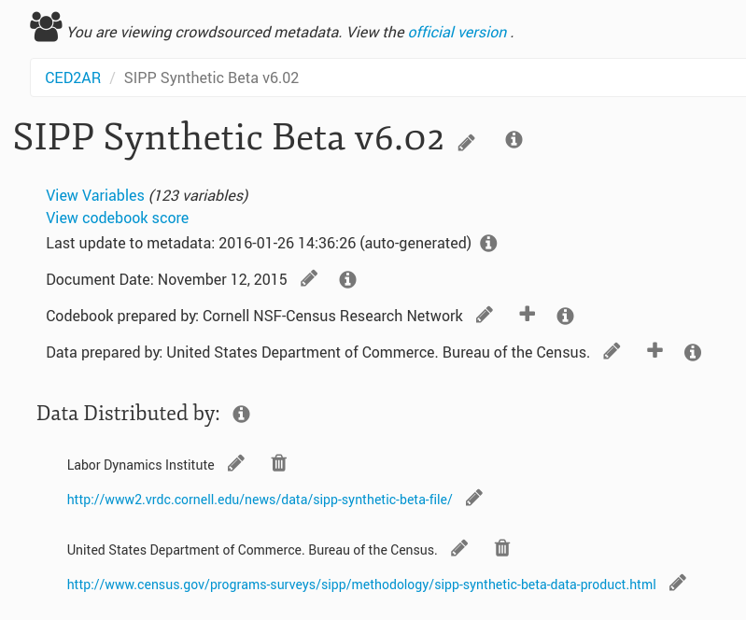

Slide 55
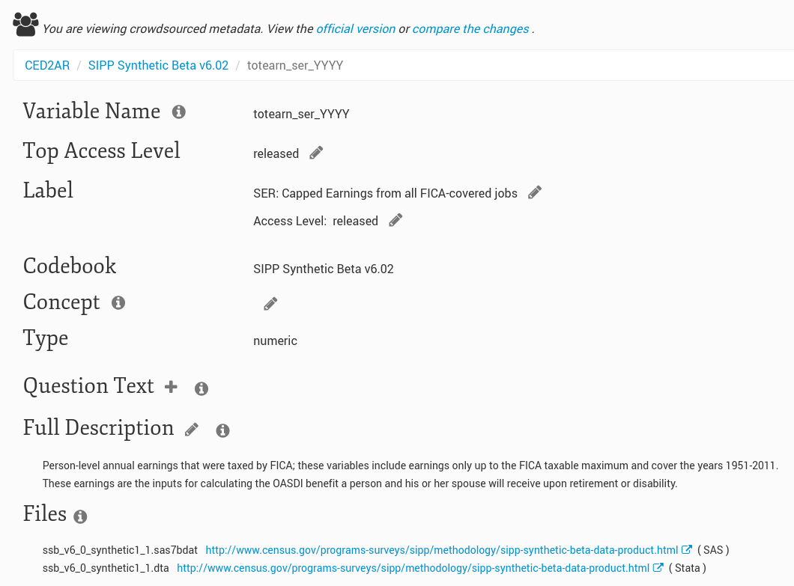

Slide 56
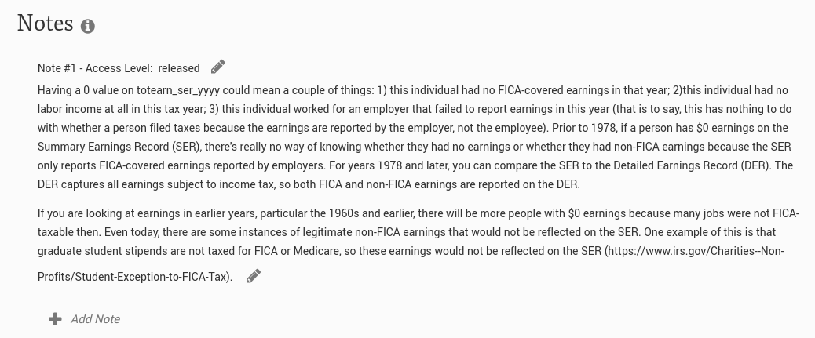

Slide 57
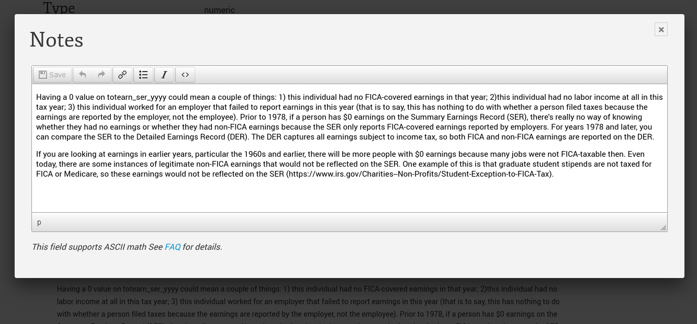

Slide 58
Basic Information Flow
Staging Area
Public Facing
Official
Metadata
Datasets
Internal
Metadata
User switches
Crowdsourced
Metadata
58

Slide 59
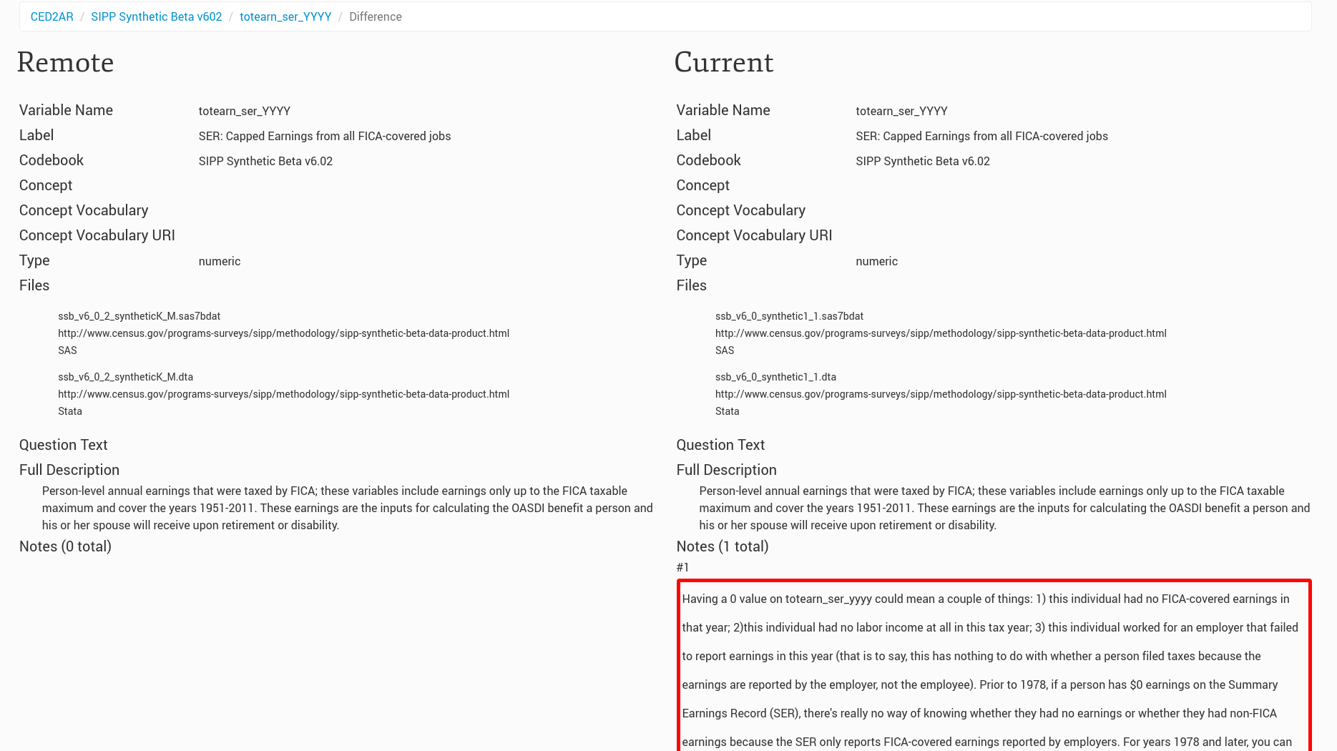
Everybody can see changes

Slide 60
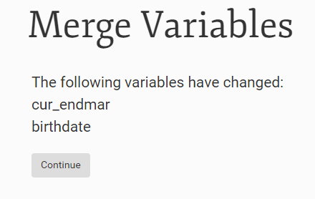
Combining Knowledge: Merging
Curators are given an interface to merge crowdsourced documentation with official

Slide 61
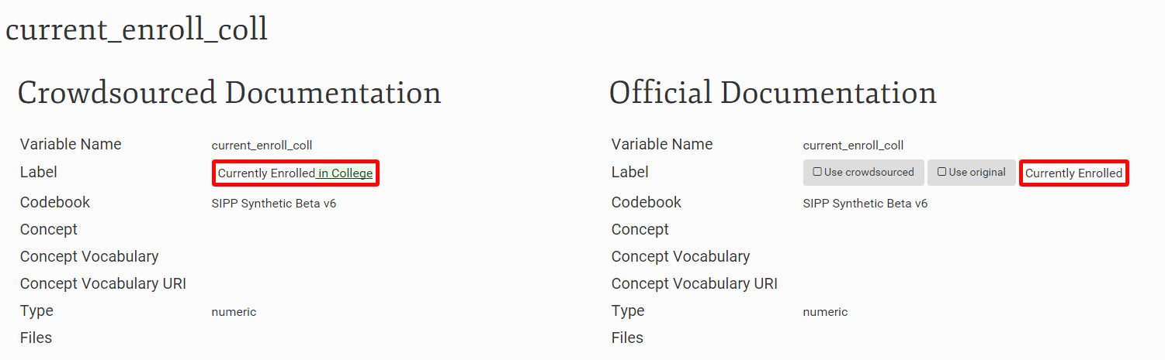
Combining Knowledge: Merging

Slide 62
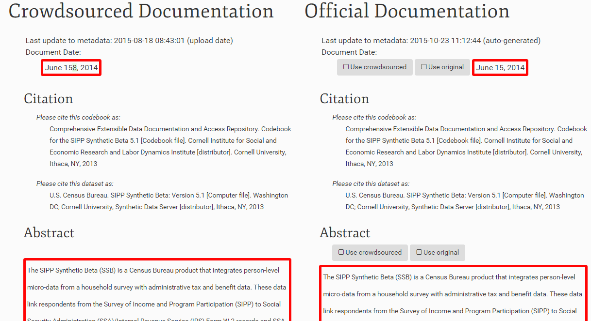
Combining Knowledge: Merging

Slide 63
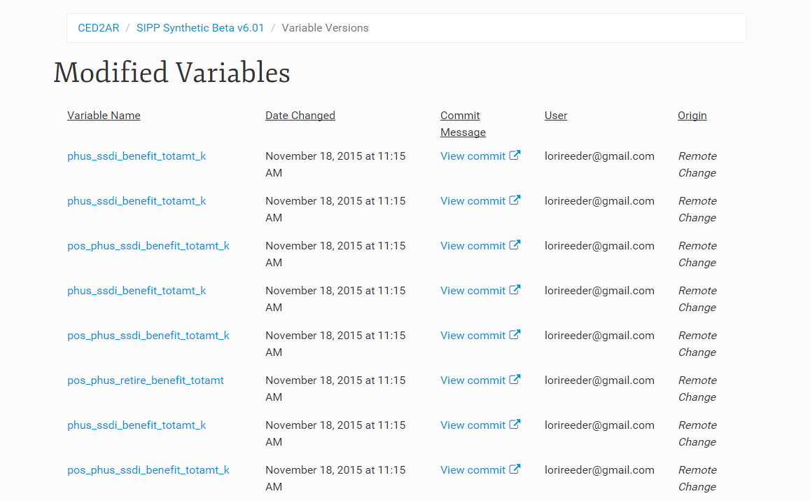
Combining Knowledge: Citations
Contributors can be tracked for each of their changes

Slide 64
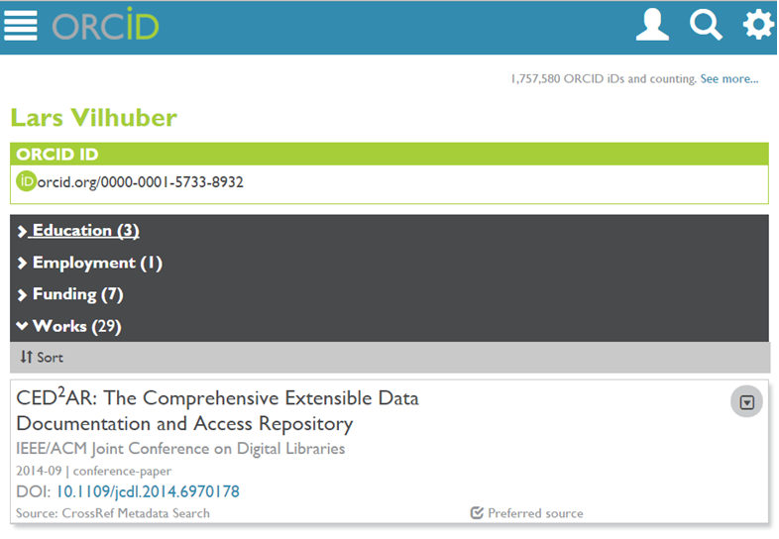
Combining Knowledge: Citations

Slide 65
Next steps

Slide 66
Making CED²AR v2 robust
Addition of UTF-8 editing support (Spanish, French, Portuguese, etc.)
Additional fields (link to survey questions, anything within DDI-C)
Bug fixes

Slide 67
Making CED²AR scalable in V3
Current implementation of CED²AR is packaged for a single server (=portable)
Already a scalable archive backend (git)
Could be fronted by a load balancer
But live server is not scalable
Current implementation of CED²AR is tied to a limited schema – adding schema is hard

Slide 68
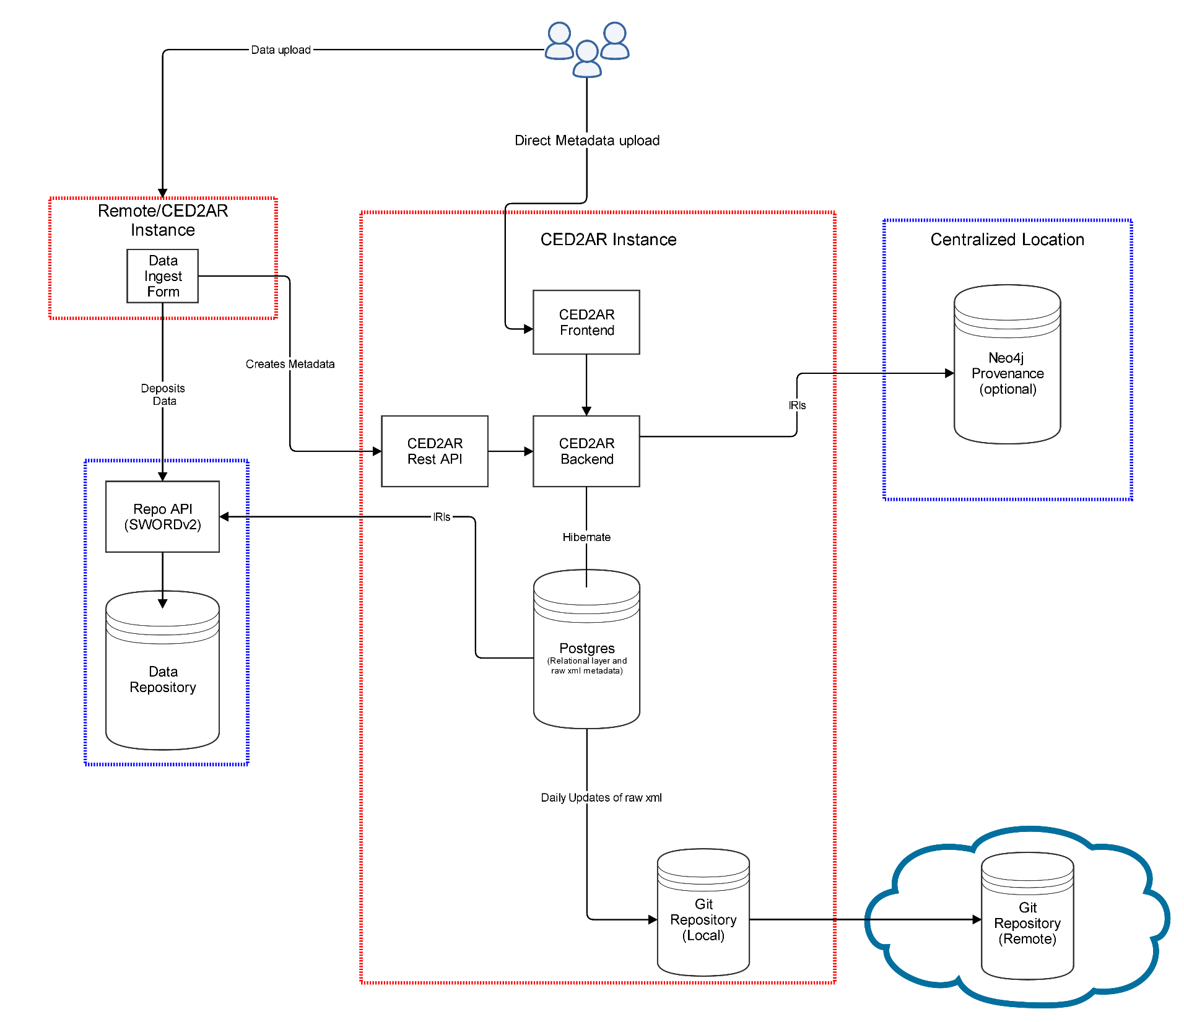

Slide 69
Thank you!
Questions?
ced2ar-devs-l@cornell.edu

Slide 70
Extra Slides

Slide 71
Technologies Used
What technologies are used to build CED²AR?
Server: Apache/Tomcat
Databases: BaseX and Neo4j
Primary Languages/Frameworks:
Java
Spring MVC
Bootstrap, JQuery, LESS

Slide 72
Generating Metadata
Convert data to metadata
Online or offline conversion
Can start with Stata, SPSS, SAS, R, ASCII or a relational DB
We generate DDI 2.5 (codebook)

Slide 73
Architecture
Codebook 1.0
Master Branch (Official version)
1. User gets copy of DDI to edit
User Contributed Branch
Codebook 1.0
Notes:
User works off their own branch, or copy of the official codebook

Slide 74
Architecture
Codebook 1.0
Master Branch (Official version)
1. User gets copy of DDI to edit
User Contributed Branch
Codebook 1.0
Codebook 1.0 rev 1
Codebook 1.0 rev 2
…
Codebook 1.0 rev N
2. Each edit is versioned
Notes:
User make revisions to DDI
As they do so, the data owner can see these changes

Slide 75
Architecture
Codebook 1.0
Master Branch (Official version)
Codebook 1.1
1. User gets copy of DDI to edit
3. Data provider merges user’s edits back into official DDI
User Contributed Branch
Codebook 1.0
Codebook 1.0 rev 1
Codebook 1.0 rev 2
…
Codebook 1.0 rev N
2. Each edit is versioned
Notes:
At a certain point the data owner decides to merge any of the user’s changes back into the official version

Slide 76
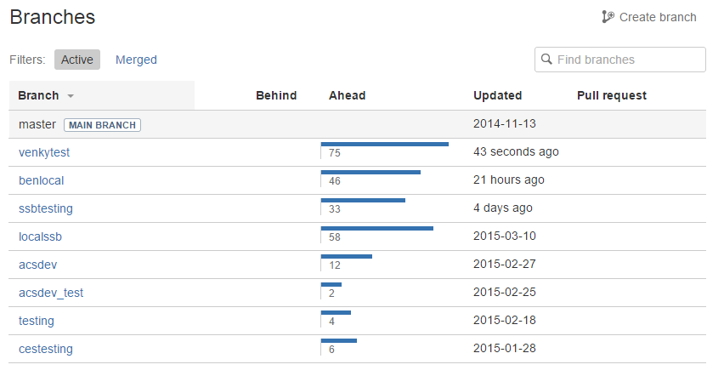
Architecture
Notes:
In reality, each network of CED2AR instances has more than two branches
A branch can track all the change on one server
Or all the changes on a single user’s desktop

Slide 77
Architecture
Server
Database
Web
Application
Local Repository
Remote
Repository
Notes:
Database only has valid DDI XML
Web application controls data flow
Access to the repository can vary, and can be manually changed or updated with ced2ar

Slide 78
Architecture
CED²AR Instance
Server
Remote
Repository
Notes:
Everything within a single server we refer to as an instance of ced2ar

Slide 79
Architecture
CED²AR Instance
Remote
Repository
CED²AR Instance
CED²AR Instance
CED²AR Instance
Notes:
-CED2AR is not a single website

Slide 80
Architecture
CED²AR Instance
Remote
Repository
CED²AR Instance
CED²AR Instance
(Official)
CED²AR Instance
CED²AR Instance
Notes:
Official copy describes authoritative copy can be found

Slide 81
Remote Location
Our implementation uses Bitbucket
Commit messages describe changes
Users linked by email address
Commit hashes are stored on CED²AR
Remote synchronization is optional
Notes:
-Changed synchronized with cloud based repository called BitBucket
-Changes are available to view or download online
-Each commit is a compilation of changes
--Within the commit message, user’s edits are referenceable by unique elements in DDI and their email address

Slide 82
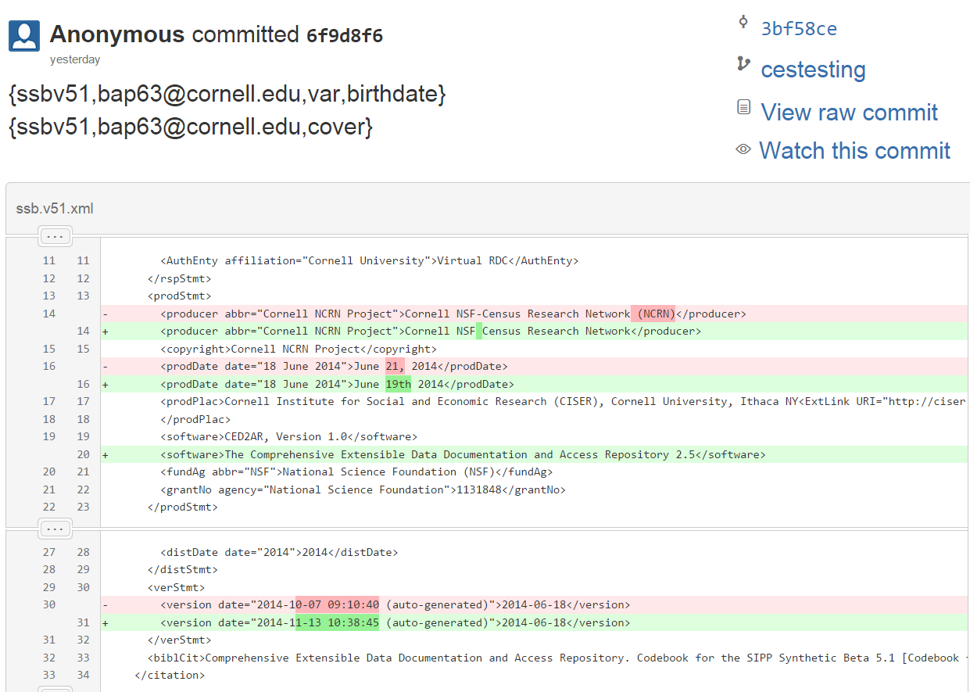
Remote Location
Notes:
Remote repository could be cloud based, local, or even offline
User has the possibility to disable remote pushes

Slide 83
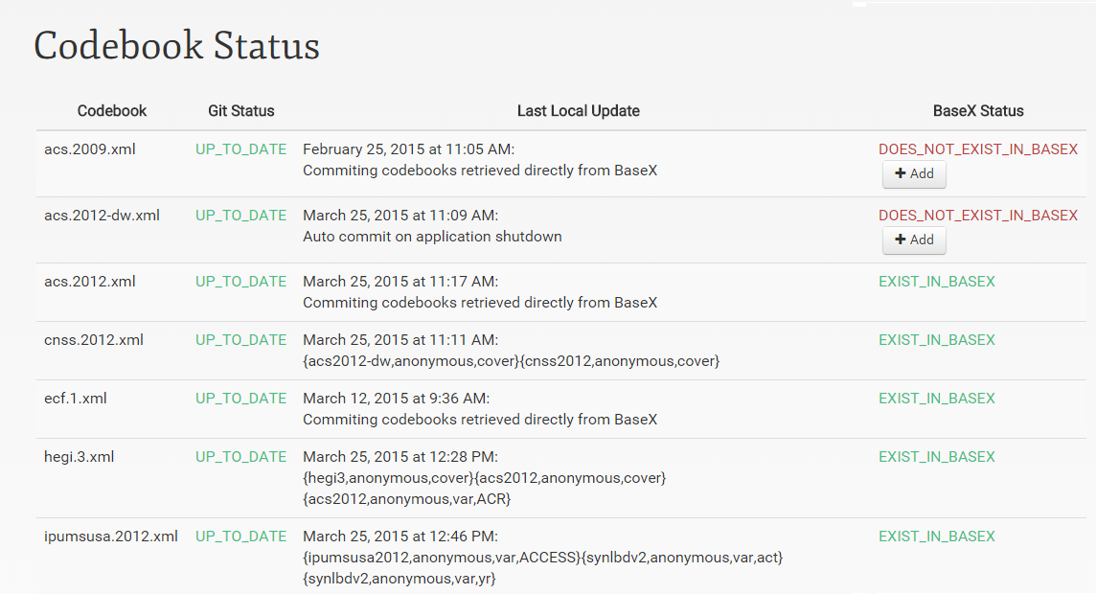
Tracking Changes
Notes:
Control to manage the flow of metadata This allows you to:
-Add codebooks from other instances
-Resolve conflicts
-Delete invalid codebooks
-Push or pull changes

Slide 84
Continued Work: Improving merge control
Codebook 1.0
Master Branch (Official version)
Codebook 1.1
1. User gets copy of DDI to edit
3. Data provider merges user’s edits back into official DDI
User Contributed Branch
Codebook 1.0
Codebook 1.0 rev 1
Codebook 1.0 rev 2
…
Codebook 1.0 rev N
2. Each edit is versioned

Slide 85
Continued Work: The uncontrolled merge
Workflow as described assumes metadata curator merges information
Within the limits of a 24-hour day: what’s the likelihood that that process scales?
Alternate: “wiki” methodology

Slide 86
Architecture (alternate)
Master Branch (Official version)
Codebook 1.0
Wiki Branch (Community version)
Codebook 1.0
Notes:
The data provider maintains the master branch of metadata, which is practically read only.
The from the master branch, a wiki branch, or community branch is contributed.

Slide 87
Architecture (alternate)
Master Branch (Official version)
Codebook 1.0
Wiki Branch (Community version)
Codebook 1.0
2
User Branches
Users pull from wiki branch into any instance of CED²AR
1
Notes:
As users edit on different platforms they

Slide 88
Architecture (alternate)
Master Branch (Official version)
Codebook 1.0
Wiki Branch (Community version)
Codebook 1.0
Codebook rev 1
2
User Branches
Users push back to branch manually
1

Slide 89
Architecture (alternate)
Master Branch (Official version)
Codebook 1.0
Wiki Branch (Community version)
Codebook 1.0
Codebook rev 1
2
User Branches
3
1
New users work off most recent revision by default

Slide 90
Architecture (alternate)
Master Branch (Official version)
Codebook 1.0
Wiki Branch (Community version)
Codebook 1.0
Codebook rev 1
…
Codebook rev X
2
User Branches
3
1

Slide 91
Architecture (alternate)
Master Branch (Official version)
Codebook 1.0
Wiki Branch (Community version)
Codebook 1.0
Codebook rev 1
…
Codebook rev X
2
User Branches
3
1

Slide 92
Architecture (alternate)
Master Branch (Official version)
Codebook 1.0
Wiki Branch (Community version)
Codebook 1.0
Codebook rev 1
…
Codebook rev X
2
User Branches
User is responsible for merging
3
1

Slide 93
Architecture (alternate)
Master Branch (Official version)
Wiki Branch (Crowdsource version)
Codebook 1.0
Codebook rev X
CED²AR User Interface exposes both versions
(with attribution)

